Slide 1

Automatic Humidifier
Andrew Sherwin - Woojin Kim - Jalen Chen
TA: Surya Vasanth
Professor: Dr. Jonathon Schuh

Slide 2

Problem
Environmental Protection Agency highly suggests 30-50% humidity indoors
Chemicals, gasses, pollen, mold, and other particles are reduced
Most cheap humidifiers are actually bad for the user's health
Warm mist – cause nasal passages to swell
Ultrasound – displaces minerals and bacteria
Manual humidifiers can over/under humidity
Humidifiers on market need manual water refilling

Slide 3
Solution
Cool mist humidifier
Good for health
Evaporates water off filter
Remote humidity sensing via 3 sensors
Automatic on/off humidifier based on humidity
Automatic water valve with water level sensing

Slide 4
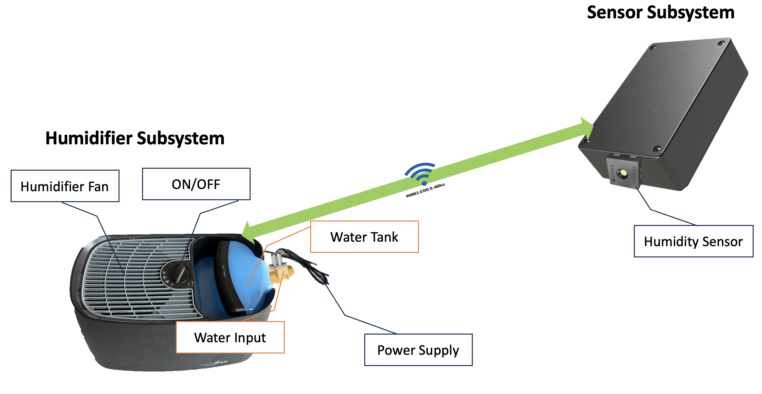
Visual Aid

Slide 5
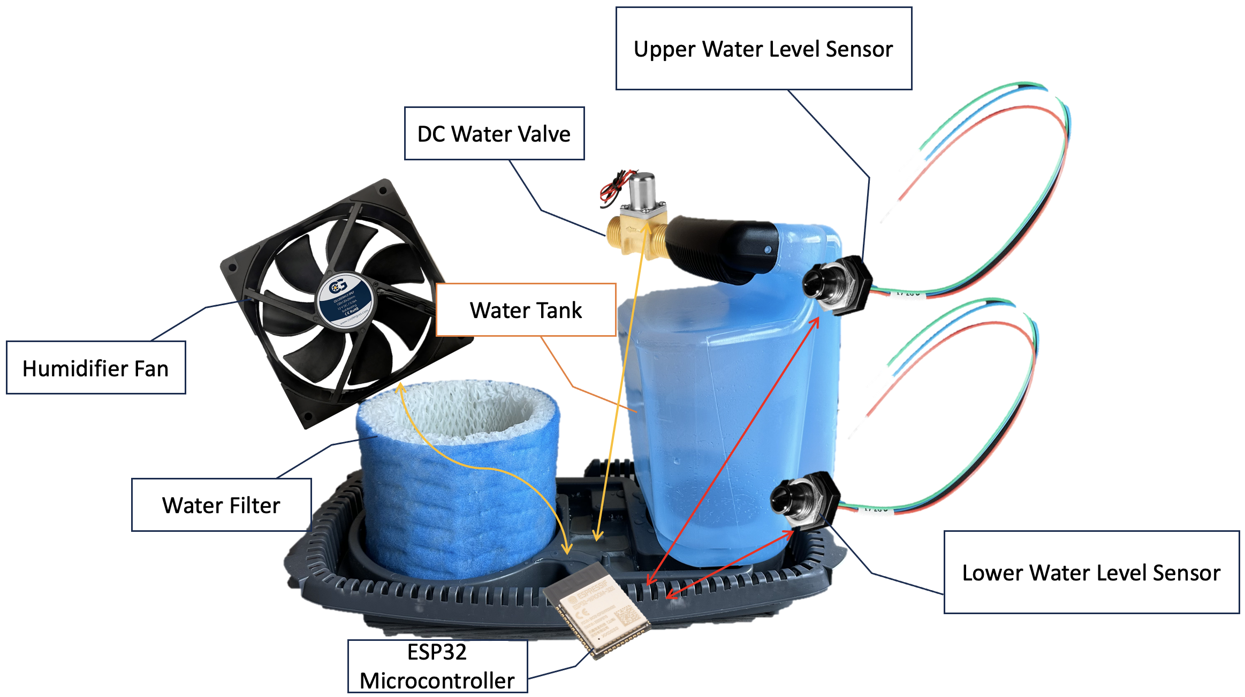
Visual Aid - Component

Slide 6

High Level 1
Humidifier's ESP32 communication with three different sensors via 2.4GHz Wi-Fi
Average humidity data from three sensors
Estimated 44ns response time to on/off the humidifier’s fan

Slide 7

High Level 2
Open/close valve to refill the water tank
Two water level sensors
Max capacity of the water tank: 4.16 liters
Filter absorbs around 150 milliliters ± 5 milliliters
Evaporation rate approximately 173 milliliters per hour

Slide 8
High Level 3
On/off fan based on pre-configured ideal humidity range, 35% and 50% humidity
This is in accordance with the EPA and FDA government guidelines for indoor humidity ranges

Slide 9
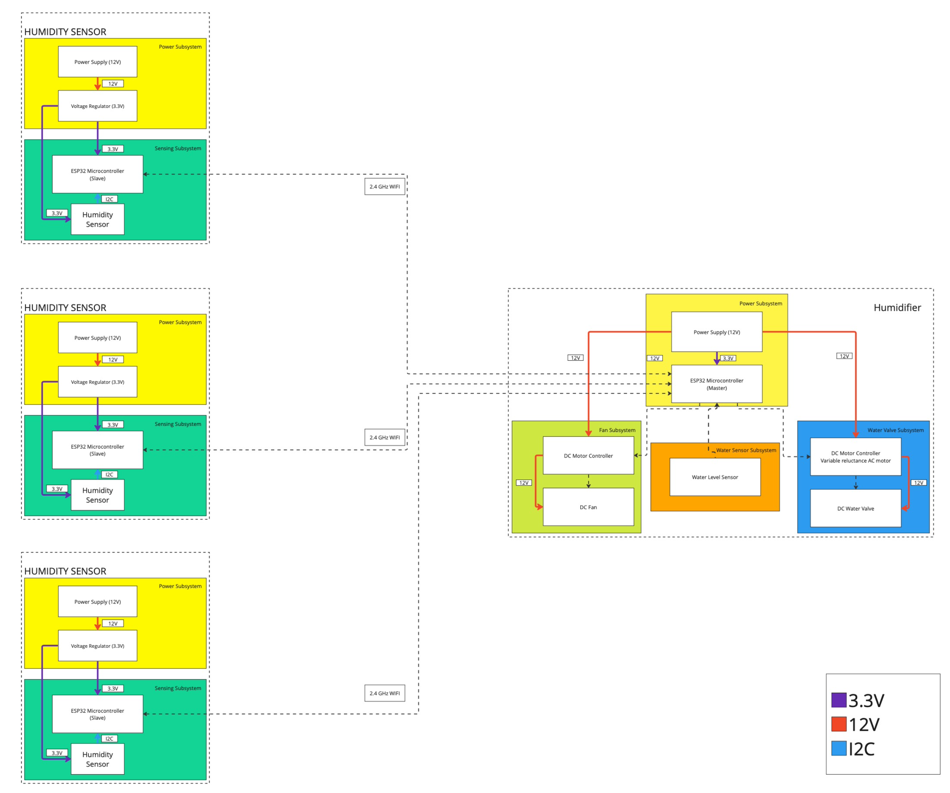
Block Diagram

Slide 10
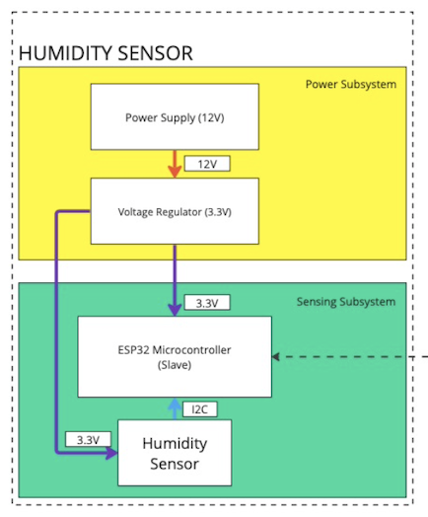
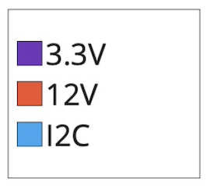
Block Diagram - Sensor

Slide 11
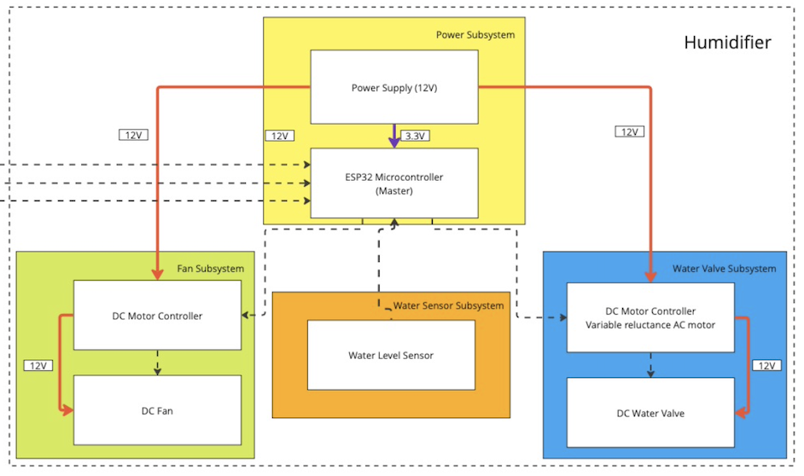
Block Diagram - Humidifier

Slide 12
Humidifier Subsystem Requirements
12V input regulated at 3.3V with adjustable regulator
ESP32 receives humidity sensor readings from other ESP32
ESP32 should read water level and operate DC water valve
ESP32 should turn on fan depending on set humidity range

Slide 13
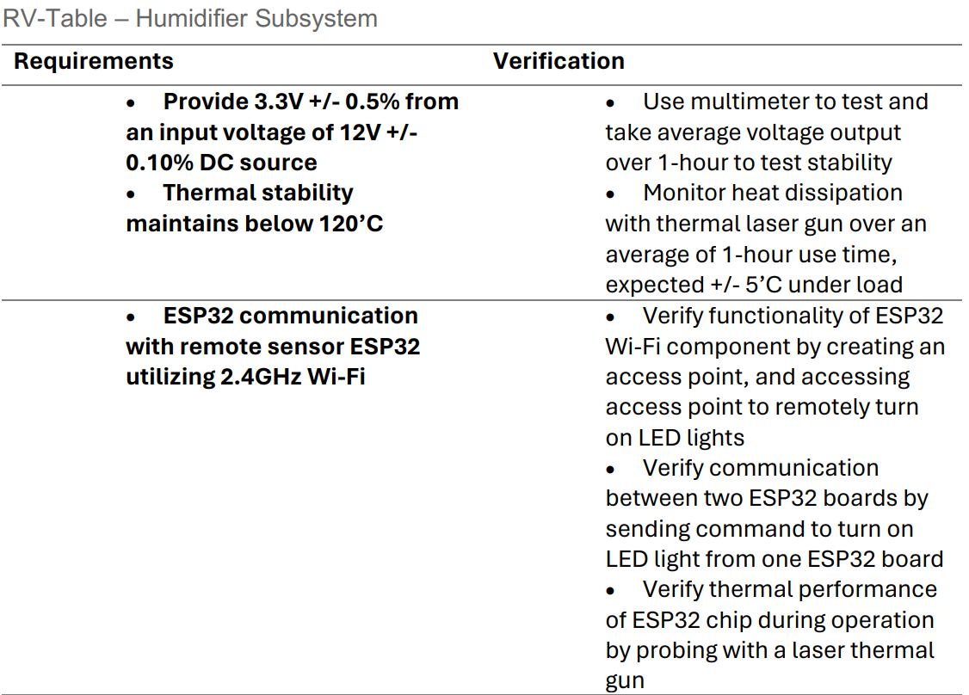
RV Table – Central Humidifier Subsystem (1)

Slide 14
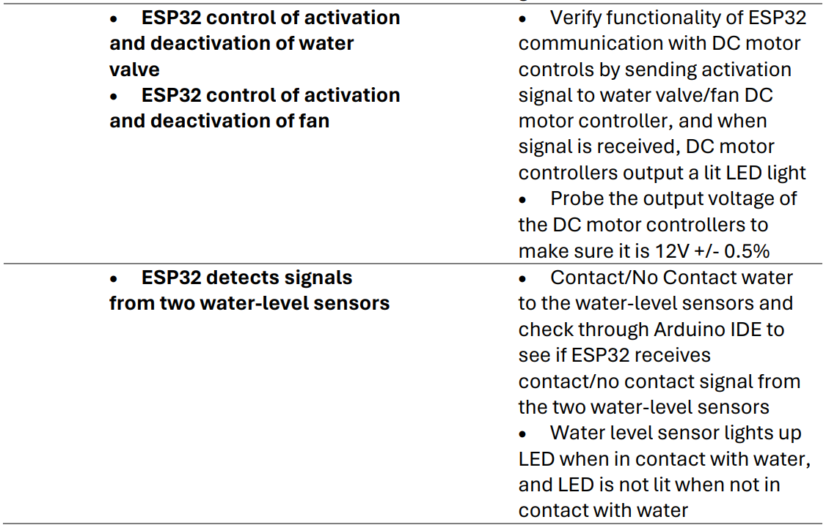
RV Table – Central Humidifier Subsystem (2)

Slide 15
Sensor Subsystem Requirements
12V input regulated at 3.3V with adjustable regulator
ESP32 sends humidity sensor readings to other ESP32
Communicate with SHT45 sensor via I2C without data loss
ESP32 will use the same frequency as SHT45
Humidity reading should be +/- 1% compared to other sensors

Slide 16
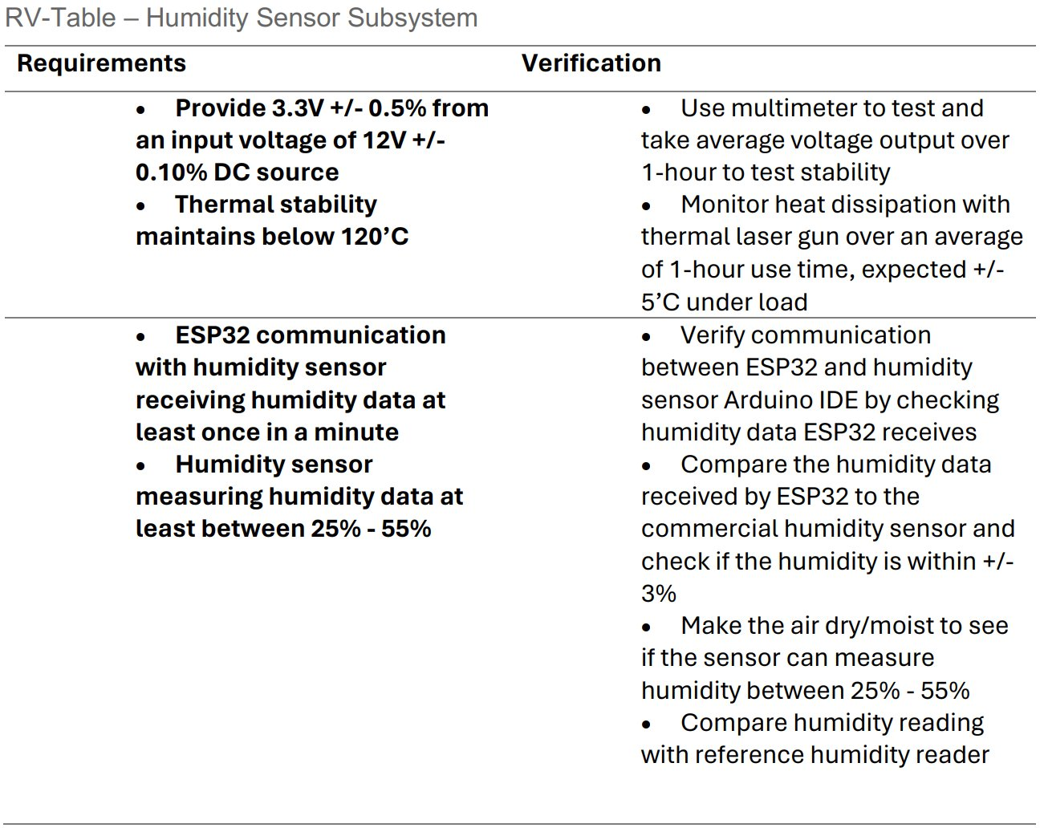
RV Table – Humidity Sensor Subsystem

Slide 17
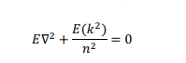
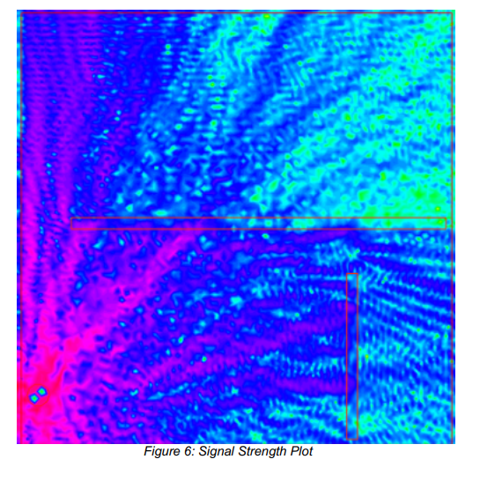
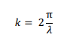
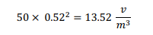
Tolerance Analysis
This equation is used to calculate the net electric field and it's fluctuation within a set area, such as the room we will be testing in.
This is the expanded equation for the angular wavenumber that will be used to calculate the equation above.
This is an example calculation using values that we estimated based on the layout of the room.

Slide 18
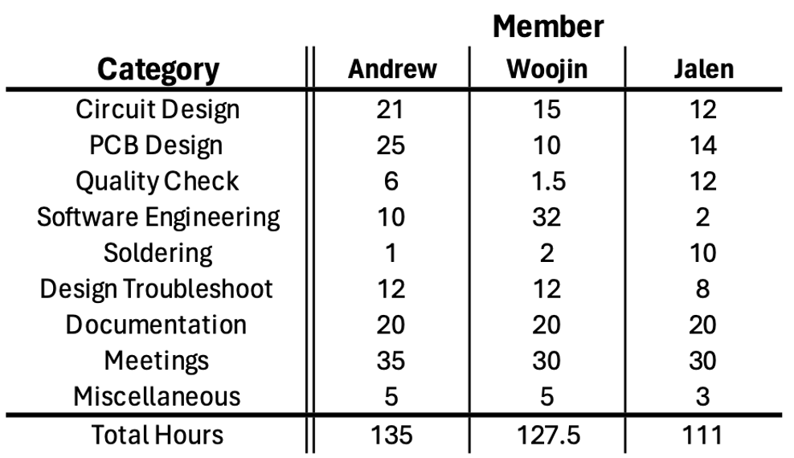
Labor Table

Slide 19
Your Oasis Awaits: Refresh, Rejuvenate, Breathe

Slide 20
Questions for instructors
AC to DC converter method is a bit expensive, are there better ideas
Turning humidifier on/off
Using electric relay similar to wall timers

